Slide 1

WEBSCAN PRO
– Automated Web Application Security Testing Tool

Slide 2
The Problem
Web applications are highly vulnerable to attacks such as SQL Injection, XSS, and IDOR due to poor validation and access control.
Solution
WebScanPro is an automated security testing tool that scans a given URL, detects vulnerabilities, and generates a structured security report.
Objectives
Detect common vulnerabilities (OWASP Top 10)
Automate penetration testing
Provide mitigation suggestions
Generate visual security reports

Slide 3
Tools and test platforms
Languages: Python
Libraries: Requests, BeautifulSoup, Streamlit.
Testing Platforms:
Output: HTML/PDF Security Report
DVWA
OWASP Juice Shop
bWAPP

Slide 4
Week-1
Project Initialization & Setup
Problem
Manual security testing is time-consuming and inconsistent.
Approach
Defined project goals
Studied OWASP Top vulnerabilities
Set up vulnerable applications locally

Slide 5
Week-1
Solution Implemented
Installed DVWA / Juice Shop using XAMPP or Docker
Explored pages, forms, URLs, parameters
Output
Working vulnerable web app environment
Identified attack surfaces

Slide 6
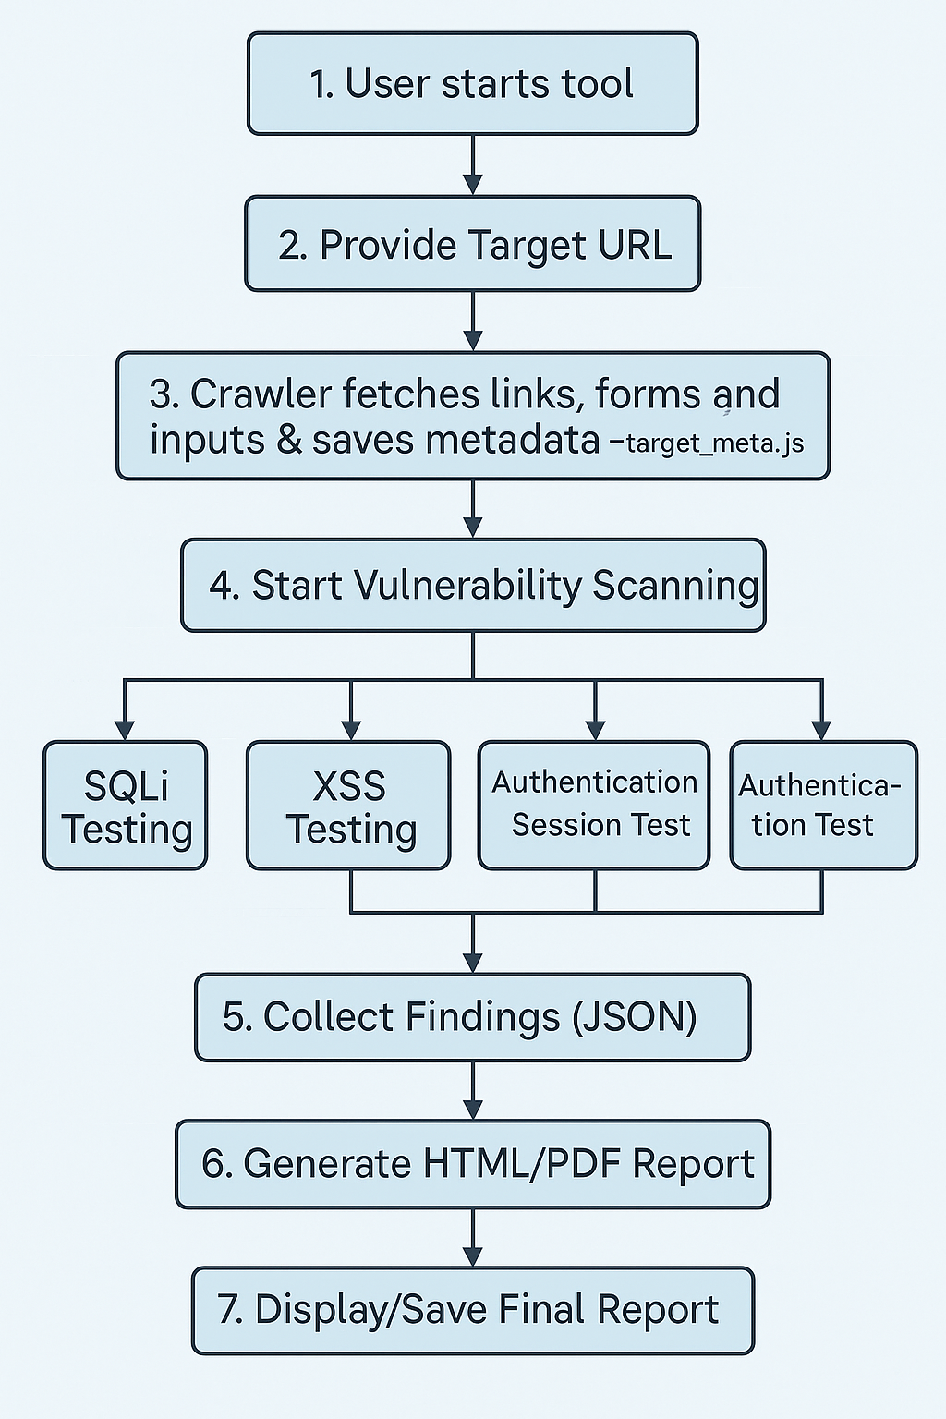
Workflow:

Slide 7
Week-2
Use tools like BeautifulSoup or Selenium to extract interactive elements.
Problem
Security testing requires knowing all entry points (forms, links, inputs).
Approach
Web crawling
HTML parsing
Solution Implemented
Developed crawler using BeautifulSoup

Slide 8
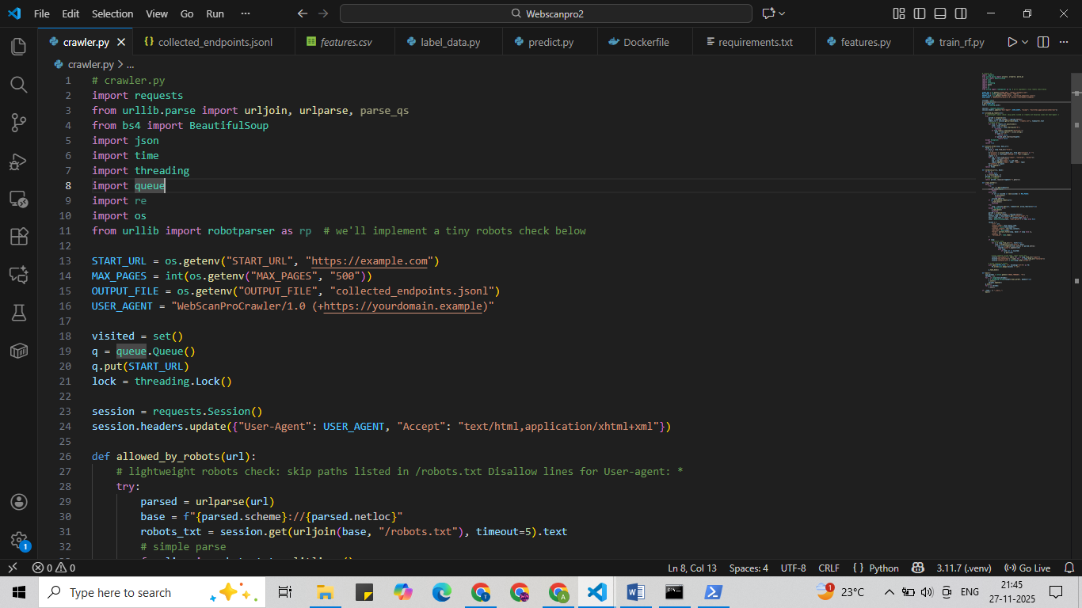
Week-2
Extracted:
URLs
Forms
Input fields
Parameters
Output
Structured metadata of target website

Slide 9
Week-3
Problem
Improper input validation leads to SQL Injection attacks.
Approach
Payload-based testing
Error response analysis
Solution Implemented
Injected SQL payloads (' OR 1=1 --)
Analyzed server responses
Detected vulnerable endpoints
Output
SQL Injection findings
Severity classification
Fix suggestions (Prepared Statements)
SQL Injection Testing

Slide 10
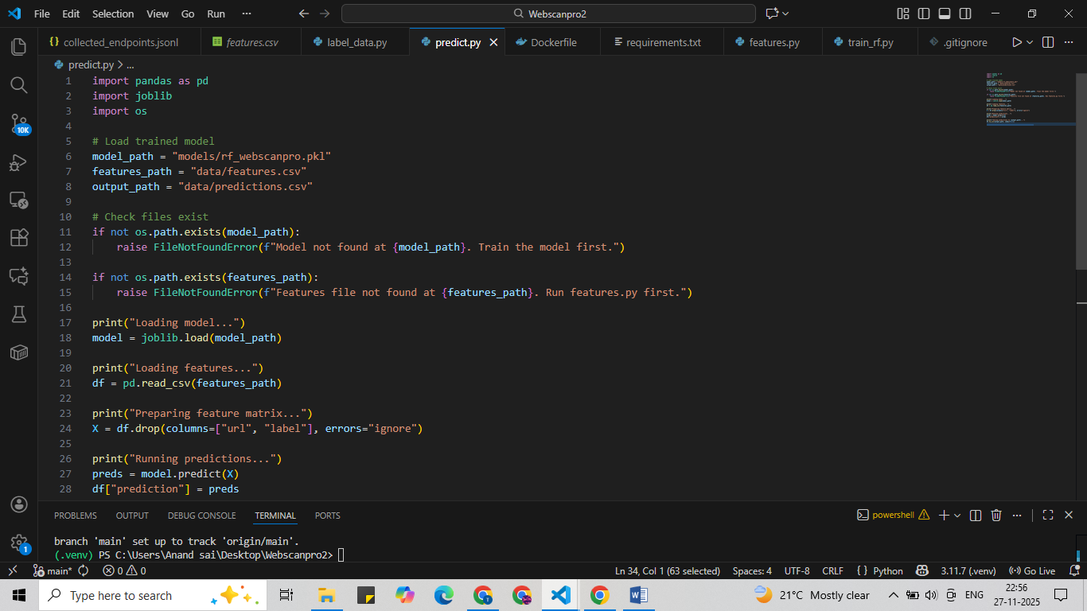
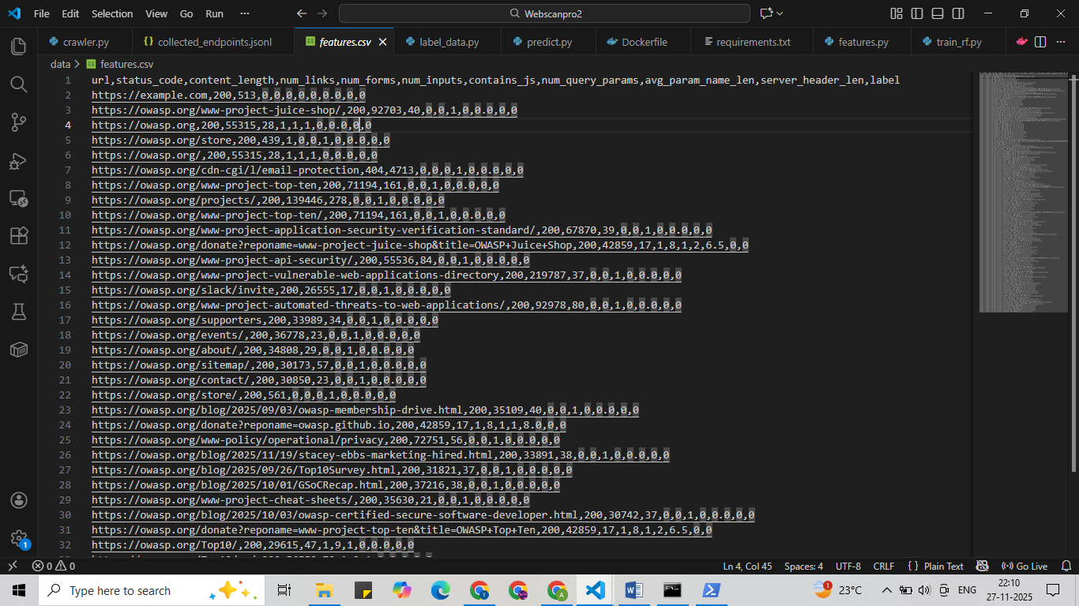
Output:

Slide 11
Week-4
Cross-Site Scripting (XSS) Testing
Problem
XSS allows attackers to execute malicious scripts in user browsers.
Approach
JavaScript payload injection
DOM & response inspection
Solution Implemented
Injected XSS payloads (<script>alert()</script>)
Detected reflected & stored XSS
Output
Vulnerable input fields identified
Mitigation tips (Input sanitization, CSP)

Slide 12
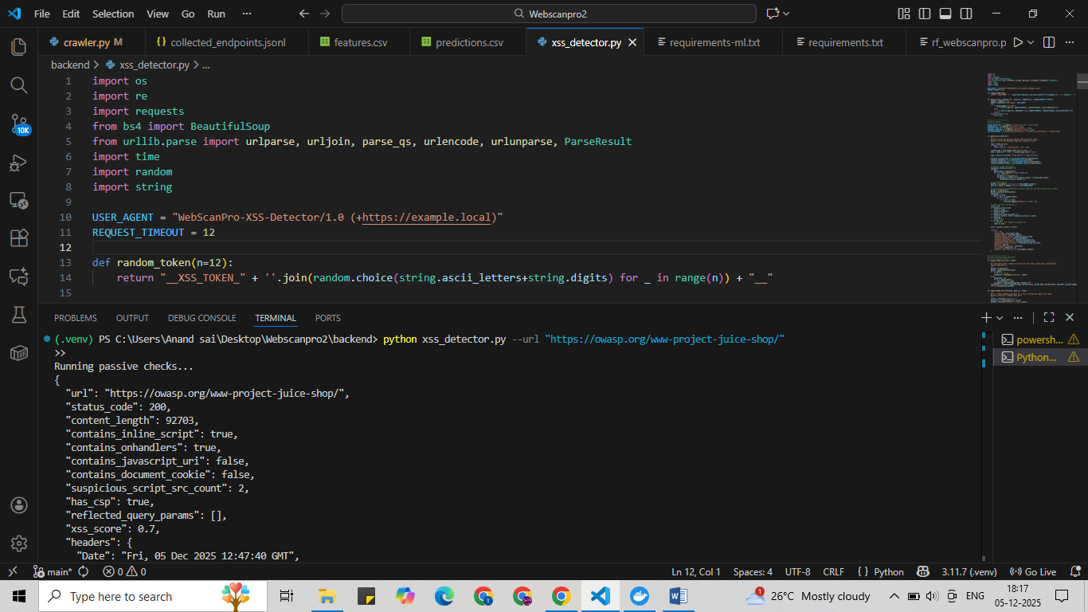
Output:

Slide 13
Week-5
Authentication & Session Testing
Problem
Weak authentication leads to account compromise.
Approach
Credential testing
Session analysis
Solution Implemented
Tested weak/default credentials
Checked cookies & session fixation
Simulated brute-force attempts

Slide 14
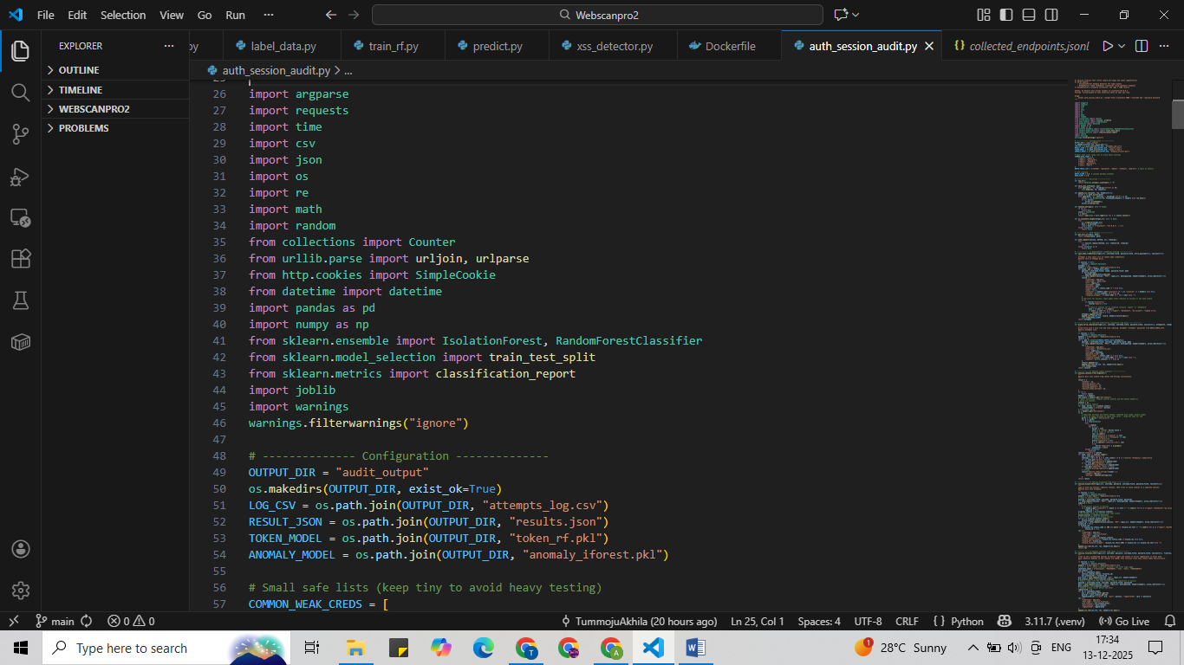
Output:
Authentication flaws
Secure session recommendations

Slide 15
Week-6
Access Control & IDOR Testing
Problem
Unauthorized users accessing restricted resources.
Approach
Parameter manipulation
Role-based testing
Solution Implemented
Modified user IDs in URLs
Tested horizontal & vertical privilege escalation
Output
IDOR vulnerabilities detected
Access control fixes (RBAC, ABAC)

Slide 16
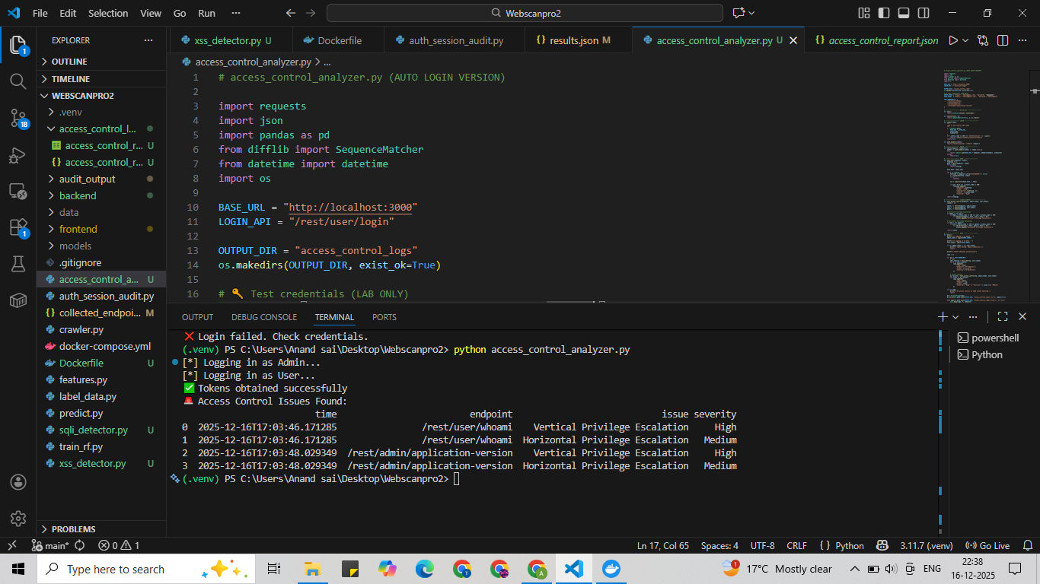
Output:

Slide 17
Week-7
Security Report Generation
Problem
Raw vulnerability data is hard to understand.
Approach
Structured reporting
Severity classification
Solution Implemented
Generated report with:
Vulnerability Type
Affected Endpoint
Severity (Low / Medium / High)
Mitigation

Slide 18
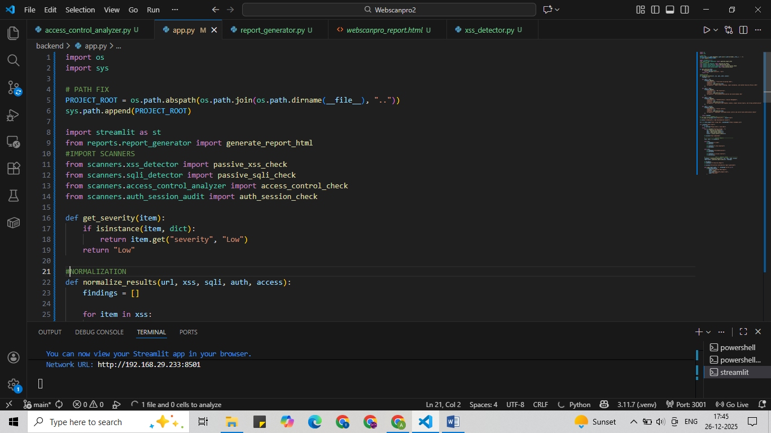
Output
HTML / PDF security report
Visual summaries

Slide 19
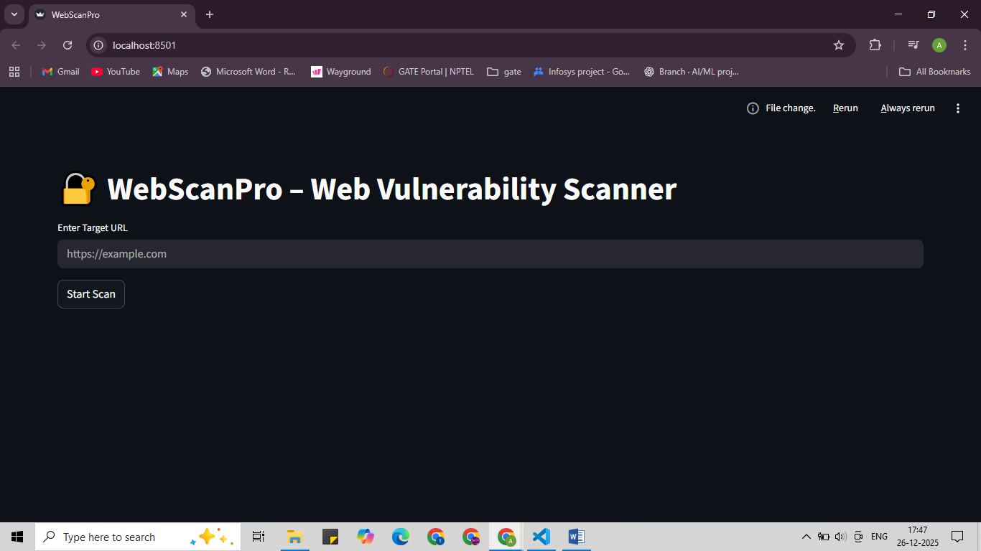
Final Output:

Slide 20
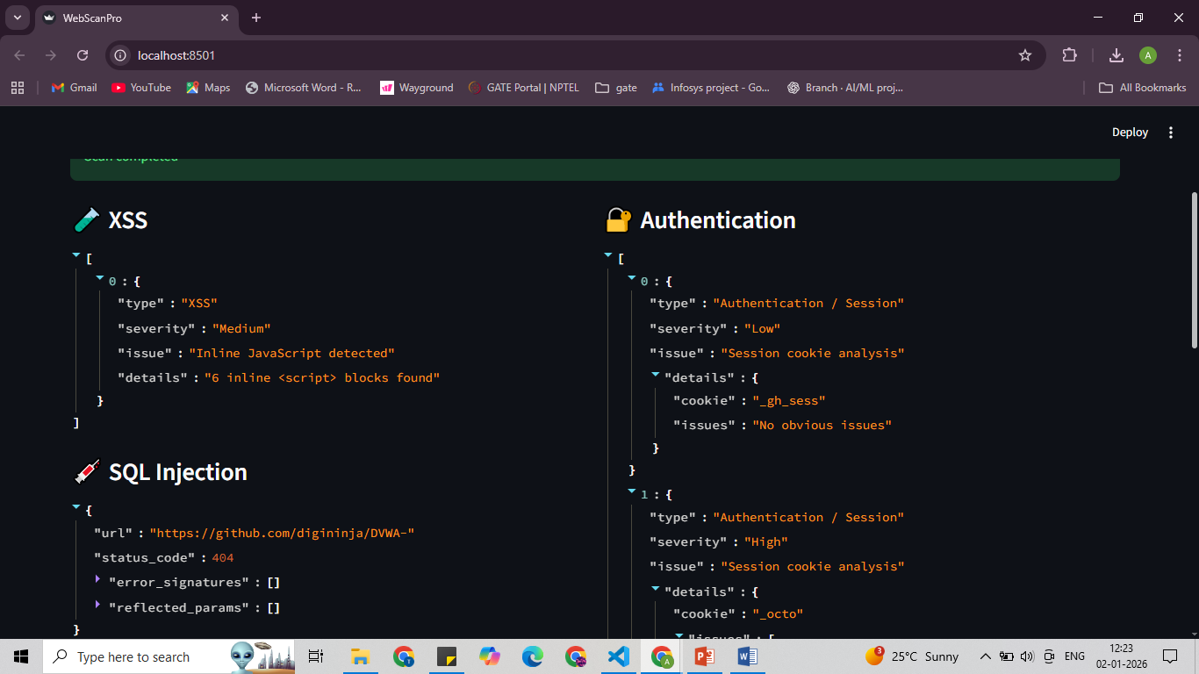
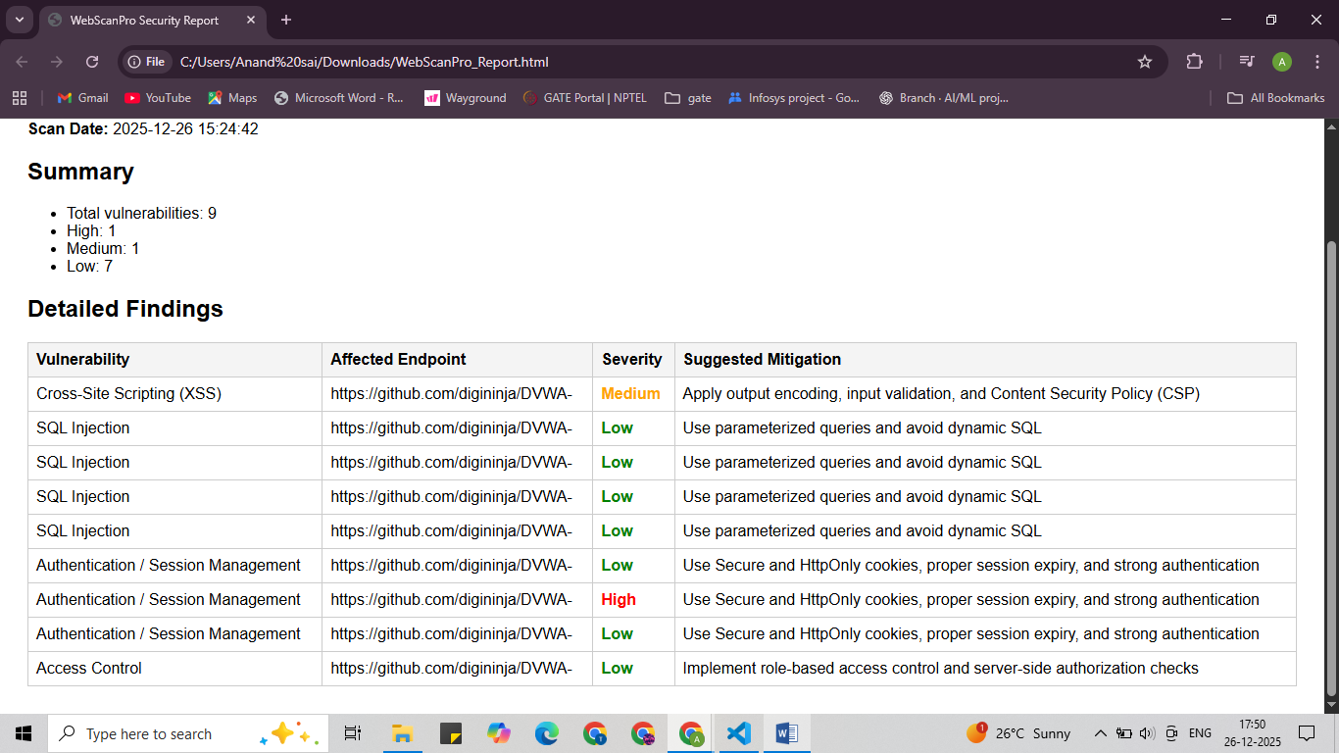
Vulnerabilites detected
Generated Report

Slide 21
THANK YOU

